Slide 1
Red, Blue, and YOU
Fight Gerrymandering with Sister District’s State Strategy
Juliet Eastland, Patrick Joyce, Caroline Kerrigan, and Michelle Ottaviano

Slide 2
"He who controls redistricting can control Congress”
- Karl Rove, GOP strategist, 2010.

Slide 3
Blue + Red for a Bluer Tomorrow | www.sisterdistrictma.com
Notes:
Every 10 years, census is taken and based on population changes
ReAPPORTIONMENT happens -- when the state population determines the number of representatives for that state in the Congressional House of Representatives
REDISTRICTING: changes in # representatives leads to redistricting in 2021, with a stated goal of evenly dividing voters into approx equal size districts.
Census projections show: Per Brennan Center - red/blue state leg
Gains (2) TX, FL, (1) AZ, CO, NC, MT, OR
Losses (2) NY, (1) AL, IL, MI, OH, PA, RI, WV, maybe CA
Red states projected to have a net gain in seats, but red states also have more overall changes and more chances to redistrict fairly or unfairly.
Keep in mind -- this won’t happen again until 2031.

Slide 4
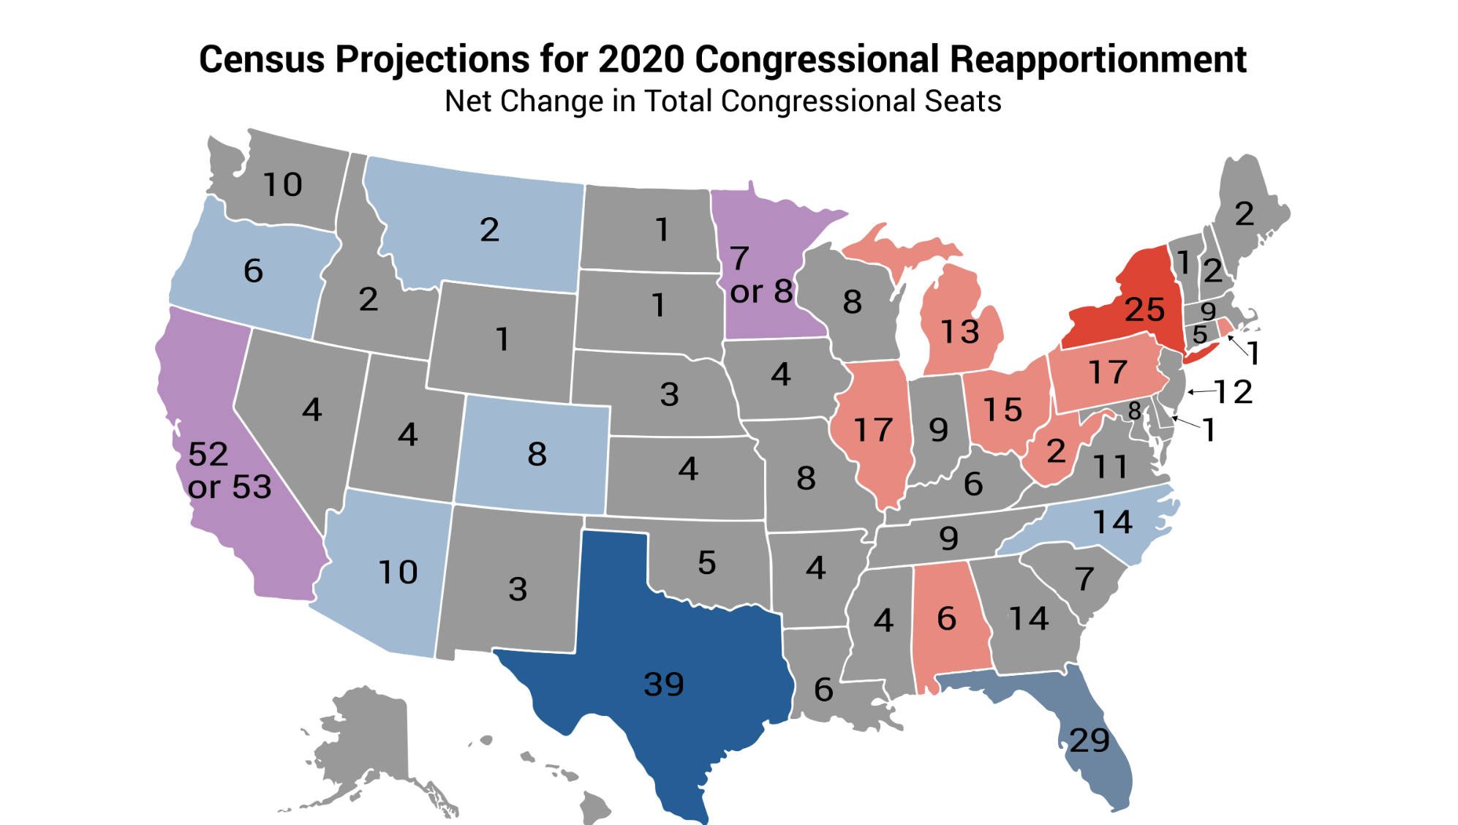
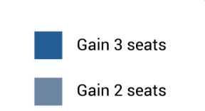
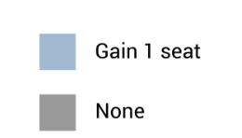
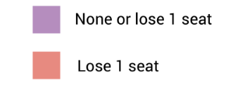
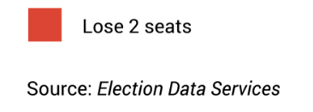
Census and Redistricting

Slide 5
States Control Redistricting
The party in power draws the maps!
12
21
33
Notes:
The party in power at the state level draws the maps - and the GOP controls ~ ⅔ of those states!
This reality is more important than in THIS election year because the 2020 census / 2021 redistricting.
Projections are that currently GOP-controlled states will have a net gain in Congressional seats based on population changes and it’s our LAST CHANCE to get Dems elected who can influence maps.
Note: party in power based on state leg (not Governor).
Dems: 9+3 = 12: OR, NV, NM, IL, NY, MA, RI, MD, VA, NH(blue leg/R gov), ME (blue/need 66%),, MN (D Gov/DHouse)
GOP: 18 + 3 = 21 NE, KS, OK, TX, IA, MO, AR, MS, AL, GA, FL, SC, NC, TN, KY, IN, OH, WV WI(D Gov only), LA(D Gov), PA (D Gov)

Slide 6
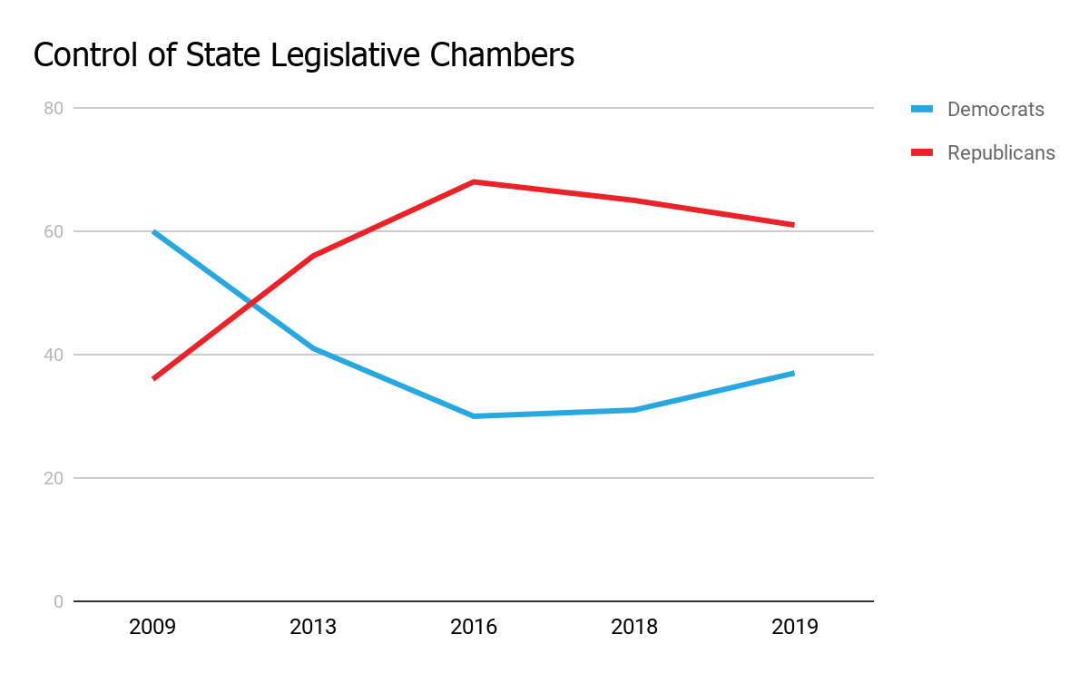
What Happened?!
Republicans quietly poured millions into state legislative races and Democrats lost approximately 1,000 seats between 2010-2016.
Data gathered from Ballotpedia.
Blue + Red for a Bluer Tomorrow | www.sisterdistrictma.com
Notes:
Thanks to GOP & Koch Bros. money, between 2010-2016, Dems lost around 1,000 state legislature seats.
Many districts unchallenged for multiple cycles
Dems have been asleep at the wheel -- neglected states for too long
But things are changing. We won back a couple hundred seats in the past couple of years, but long term investment in Dem state races is needed to turn the tide and to create lasting change !
The GOP has been hugely successful in using the power they gained to retain power through gerrymandering.

Slide 7
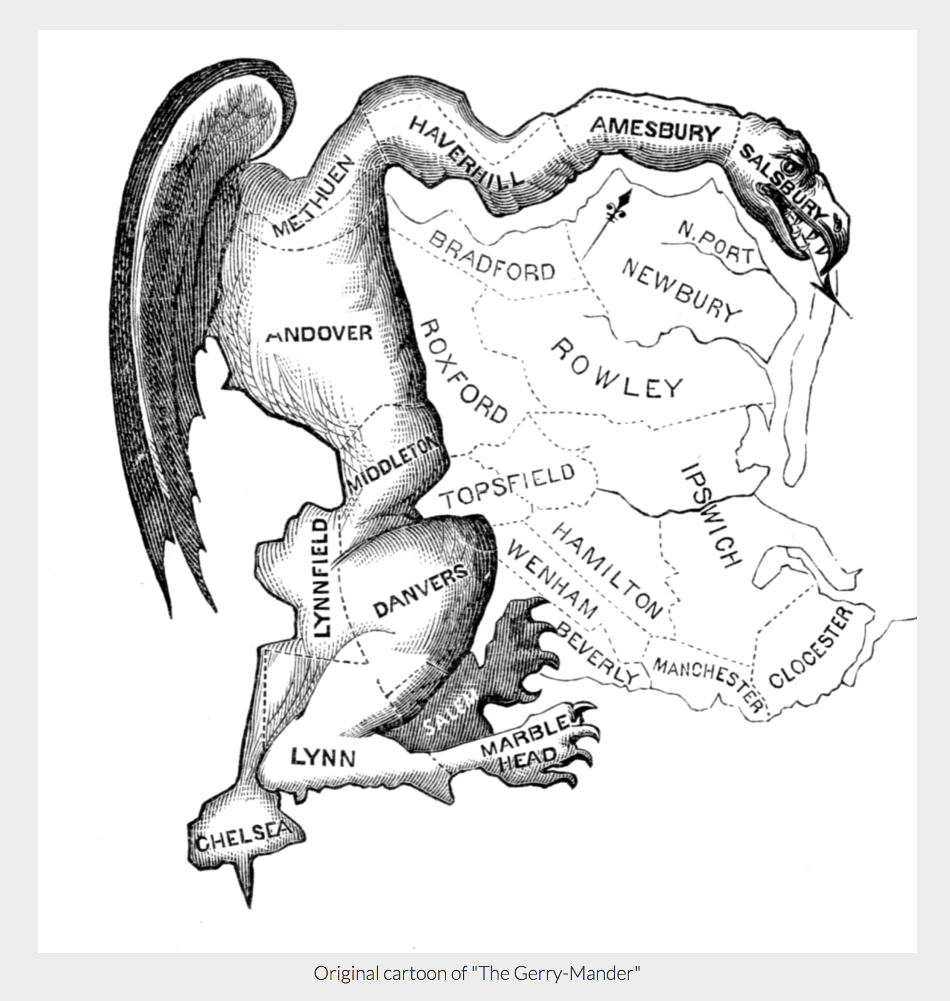
The Gerry-Mander: a cartoon that appeared in the in the 1812 Boston Gazette - lampooning Democratic-Republican efforts to redraw the maps that formerly followed county boundaries so that opponents were packed into one district.
Per Smithsonian Magazine:
Where Did the Term Gerrymander Come From?
Notes:
It’s always been around,
Got it’s name in 1812 when Democratic-Republicans, led by Elbridge Gerry right here in MA, tried to assure the outcome of the race by pack opposition into one district
Gerrymandering intentionally takes away fair representation, so that one party gains more representatives than they deserve.
NOW it’s time to test your gerrymandering knowledge

Slide 8
Test Your Gerrymandering Knowledge
Which gerrymandering phenom was exposed posthumously by his daughter for crafting racially gerrymandered districts in North Carolina?
Notes:
A: Thomas Hofeller
After death, his daughter handed over his hard drives for examination, which uncovered a trove of evidence that Hofeller was instrumental in gerrymandering around the country.
Not only that, he was one of the key contributors to the idea of adding the citizenship question to the census.

Slide 9
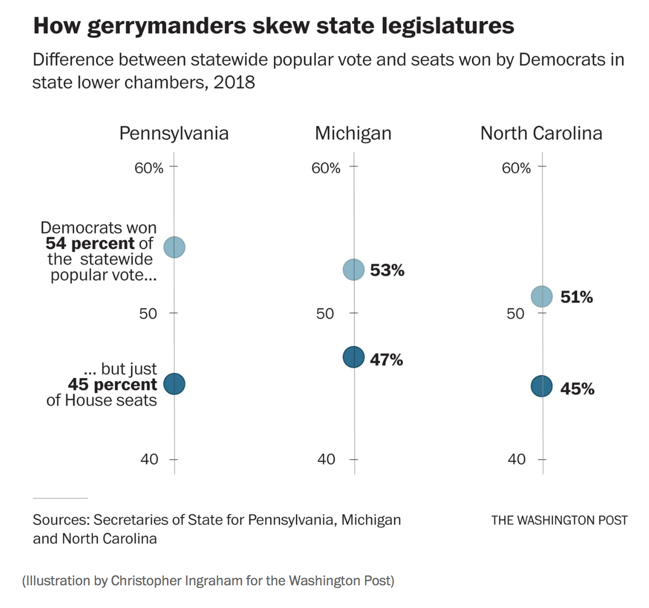
Technology & Bad Intent
Map-making technology allowed street-by-street crafting of districts
"Redistricting is like an election in reverse! It's a great event… Usually the voters get to pick the politicians. In redistricting, the politicians get to pick the voters!"
-Thomas Hofeller
at a National Conference of State Legislatures event in 2000.
Source: NPR: Redistricting Guru's Hard Drives Could Mean Legal, Political Woes For GOP
Washington Post: In at least three states, Republicans lost the popular vote but won the House
Notes:
Thomas Hoefler: "Redistricting is like an election in reverse! It's a great event… Usually the voters get to pick the politicians. In redistricting, the politicians get to pick the voters!"
GOP RedMap (Redistricting Majority Project) 2010.
Both parties are guilty of using gerrymandering to their advantage, but the GOP systematically applied extreme gerrymandering throughout the country.
PA, MI, and NC categorized as the “most extreme” maps according to the Brennan Center.
Exemplified by this chart from the Washington Post detailing how in these 3 states, Dems won the popular vote, but do not have proportional representation in the state legislature.
Before we move on we have another test of your gerrymandering knowledge.

Slide 10
Test Your Gerrymandering Knowledge
In 2018, which state’s citizens overwhelmingly voted to restore voting rights to many formerly convicted felons - only to have the GOP legislature pass a law conditioning voting on returning citizens’ ability to pay outstanding fees, fines, and restitution?
Notes:
A: Florida
Of course GOP knew exactly what it was doing.
Over 1 million former felons thought they had just been re-enfranchised,
But the GOP immediately voted for the equivalent of poll tax that would withhold the right to vote until after restitution paid - impacting 500-800,000 people
That’s the What of Gerrymandering, now we will look at how gerrymandering works and present some case studies

Slide 11
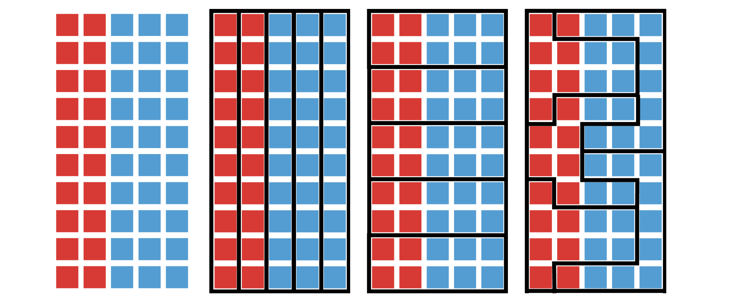
Drawing Maps - a Powerful Political Tool
One group of 50 voters -- 3 vastly different electoral outcomes
1. Perfect 2. Compact 3. Neither
50 people representation but fair compact nor fair
= Blue Win = Blue Win = Blue Win = Red Win
Blue + Red for a Bluer Tomorrow | www.sisterdistrictma.com
Notes:
Gerrymandering allows politicians to choose their voters instead of the other way around.
Lots of debate about the proper way to draw fair maps, but little debate that a solution like that shown in #3 is reasonable.

Slide 12
How To Gerrymander?
Concentrating as many of the opposing party’s supporters into as few districts as possible.
Scattering the rest of the opposing party’s supporters into districts where they have no chance of winning.
Blue + Red for a Bluer Tomorrow | www.sisterdistrictma.com
Notes:
CRACKING reduces voting power of certain party/community by splitting its population and spreading its members among several districts where they become an irrelevant minority.
PACKING concentrates voters of 1 party/community in as few districts as possible to reduce their influence on remaining districts.

Slide 13
Test Your Gerrymandering Knowledge
Which state had a district known as “Goofy Kicking Donald Duck” until it was deemed unconstitutional in 2018?
Notes:
A: Pennsylvania

Slide 14
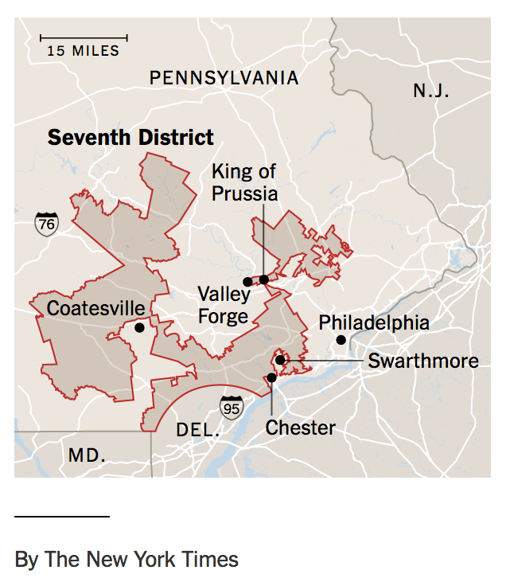
Case Study: Pennsylvania
Pennsylvania’s 7th: Goofy Kicking Donald
2012 in Pennsylvania
President Obama won by ~300,000 votes
PA Congressional candidates outpolled GOP by 100,000 votes
Republicans won 13 of 18 seats in US House
State courts deemed map violated the state constitutional guarantee that “elections shall be free and equal.”
Sources: New York Times: https://www.nytimes.com/2018/01/26/us/pennsylvania-gerrymander-goofy-district.html
Pittsburgh Post-Gazette: PA Supreme Court Releases gerrymandering opinion: 2011 map violates ‘free and equal’ elections
The New Yorker: Drawing the Line: How redistricting turned America from blue to red
Notes:
2012 Obama won by ~300,000 votes
PA Congressional candidates outpolled GOP by 100,000 votes
Republicans won 13 of 18 seats in US House
2018 - State Supreme Court struck down congressional maps as unconstitutional (it split state into 28 counties, resulting in district win Trump 12, Clinton 6).
Court-redrawn map divides state into 13 counties… Trump 10, Clinton 8. GOP filed suit (dismissed)
Requested SCOTUS stay (rejected)
Moved to impeach Democratic judges (abandoned).
SUCCESS: 2018 vote used fair maps.

Slide 15
Case Study: North Carolina
Partisan gerrymandering replaces racial gerrymandering
Actual vote 2018 ~ 51% / 49%
13 Congressional seats
Seats today: 10 / 3
Seats with fairer maps: 7 / 6
State Senate: 29 / 21
State House: 66 / 54
"I propose that we draw the maps to give a partisan advantage to 10 Republicans and 3 Democrats, because I do not believe it’s possible to draw a map with 11 Republicans and 2 Democrats”
NC Rep. David Lewis, 2016
Source: Washington Post: https://www.washingtonpost.com/business/2018/11/13/least-three-states-republicans-lost-popular-vote-won-house/
The Daily Tar Heel - Democrats win majority of statewide votes, but a minority of seats https://www.dailytarheel.com/article/2018/11/gerrymandering-election-nc-1118
Notes:
2018 vote is split approximately 50/50 between Democrats and Republican, but Republicans won - by a large number - the majority of seats in Congress and in both state chambers.
Some history:
2016: congressional boundaries deemed illegally racially gerrymandered, so congressional maps redrawn to concentrate Dems via *partisan* gerrymandering into 10 GOP / 3 Dem districts (“I propose that we draw the maps to give a partisan advantage to 10 Republicans and three Democrats, because I do not believe it’s possible to draw a map with 11 Republicans and two Democrats” - NC Rep. David Lewis, 2016).
[2019: state court strikes down *state* legislative maps because of partisan gerrymandering; legislature redraws maps.]
10/19 - state court declares 2016 congressional district map invalid due to partisan gerrymandering (challengers: map may be "the most extreme and brazen partisan gerrymander in American history”). GOP redrew map somewhat more fairly, but...
12/19: court allows this newest map to stand, citing not enough time before 2020 primaries. Result: if you drag your feet, you can use gerrymandered map!

Slide 16
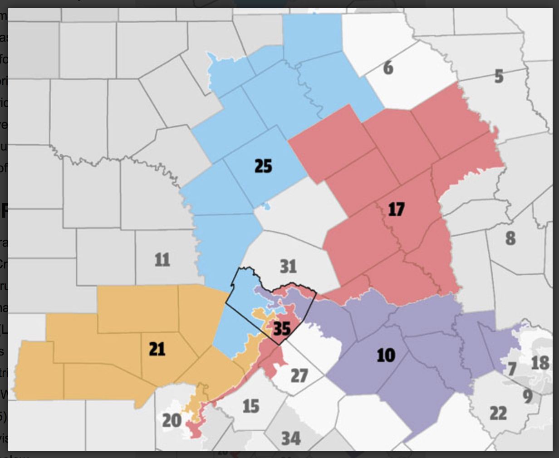
Case Study - Texas
Actual vote 2018: 53% / 47%
36 Congressional seats
Seats today: 23 / 13
Seats with fairer maps: 19 / 17
Austin TX / Travis County
(right, black outline)
Cracked into 5 different districts 4 / 1
Sources: Austin Chronicle: The Texas Hammer: Gerrymandering
Houston Public Media: Can the Texas GOP Reform Gerrymandering Before It’s Used Against Them
Notes:
Part of 5 different Congressional districts are located in Travis county (black outline). Travis divided into districts 10, 17, 21, 25, and 35.
None of these 5 districts are “anchored” (with a majority of voters) in Travis
Republicans represent for 4 of 5 districts (#10 R-Michael McCaul; #17 R- Bill Flores; #21 R- Lamar Smith; #25 R-Roger Williams; #35 D-Lloyd Doggett).
Austin Chronicle: https://www.austinchronicle.com/news/2017-03-17/the-texas-hammer-gerrymandering-gerrymandering/ Houston Public Media: https://www.houstonpublicmedia.org/articles/news/in-depth/2019/04/16/329402/can-the-texas-gop-reform-gerrymandering-before-its-used-against-them/

Slide 17
Maintaining Power
Gerrymandering gives power to representatives who can’t win based on fair maps and the actual numbers of voters. Voter suppression cements that power.
Notes:
Timing, Democratic complacence, and gerrymandering gave Republicans tremendous power in state legislatures around the country, but they couldn’t rest on their laurels. They know that pure numbers and fair maps won’t keep them in power, so they draw from a menu of tactics to suppress the vote

Slide 18
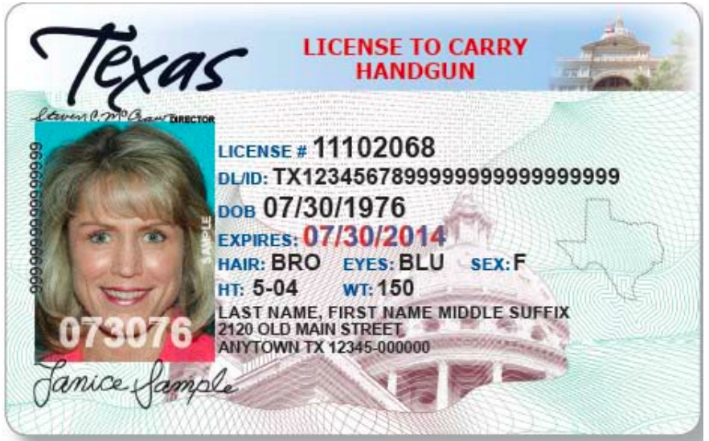
Voter Suppression Tactics
2013: SCOTUS gutted Voting Rights Act
Gun License
Student ID
Voter ID Laws
Hurdles to Student Voting
Shorten Early Voting & Polling Hours
Close Polling Locations
Purge the Voter Rolls
Source: Let America Vote https://www.letamericavote.org/news/blog/2017/5-ways-democracy-undermined-voter-suppression-playbook-exposed-2/
Notes:
The 2013 gutting of the Voting Rights Act paved the way. In Shelby v. Holder - SCOTUS invalidated key provision of Voting Rights Act that had required DOJ to “preclear” any changes in elections in states with historically discriminatory voting laws; southern states now have free rein
Voter ID Laws: 13% of black Americans, 10% of Hispanic Americans, 12% of adults living in a household with less than $25,000, 15% of 17-20 year-olds lack photo ID and 11% of 21-24 year-olds lack photo ID.
Making It Harder For Students To Vote -
Not accepting student IDs
Requiring students to register car and get NH driver’s license after voting
Early voting sites on campus closed becuase they weren’t open full hours or didn’t have enough non-permitted parking spaces
https://www.nytimes.com/2019/10/24/us/voting-college-suppression.html
Shortening Early Voting and Polling Hours
Closing and Consolidating Polling Locations (see next slides)
Purging the Voter Rolls (see next slide)

Slide 19
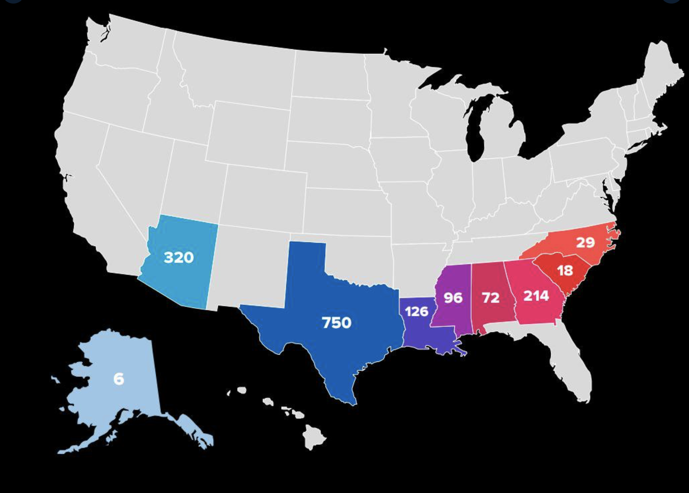
Voter Suppression in Action
1,688 polling places closed since 2012 in states previously subject to Voting Rights Act:
- 750 in Texas
- 320 in Arizona
- 214 in Georgia
- 126 in Louisiana
- 96 in Mississippi
- 72 in Alabama
Source: Twitter post from Ari Berman https://twitter.com/ariberman/status/1171478361610174470 referencing https://www.motherjones.com/politics/2019/09/report-more-than-1600-polling-places-have-closed-since-the-supreme-court-gutted-the-voting-rights-act/
Notes:
1,688 polling places closed since 2012, “Right Wing Watch” & Brennan Center
Report released by The Leadership Conference on Civil and Human Rights notes that in addition to ADA compliance, states justify closing poll locations for
School safety concern
Limited parking
Give no justification at all - “By far, the most common justification for closing polling places was no justification at all.
Or say it’s simple logic. As one election commissioner from Mississippi put it, sometimes closing polling places “just makes sense.”’

Slide 20
Test Your Gerrymandering Knowledge
Between the 2016 election and the 2018 midterms, approximately how many voters were purged from the rolls?
Notes:
A: 17,000,000 (Brennan Ctr. for Justice)
Prior to 2016, the purge rates in states that required VRA preclearance and those that did not were roughly the same.
At least 17 million voters were purged nationwide between 2016 and 2018, similar to the number we saw between 2014 and 2016, but considerably higher than we saw between 2006 and 2008;
2016–2018 a dramatic shift - purge rates in states that previously required preclearance were 40 % higher than the purge rate in other states (Brennan Center)
https://www.brennancenter.org/our-work/analysis-opinion/voter-purge-rates-remain-high-analysis-finds
So, voter suppression and gerrymandering work hand in hand to cement Republican power that is does not reflect the will of the people. What can we do about it? The answer lies in state legislatures.

Slide 21
Sister District Project
State Strategy

Slide 22
States draw districts, but what else?
State elections energize the grassroots (“reverse coattails”).
State leaders become national leaders – feed the leadership pipeline.
State campaigns need us; small $$ have an outsized impact.
State laws impact our day-to-day lives & progressive (or regressive) policies travel across state lines
Blue + Red for a Bluer Tomorrow | www.sisterdistrictma.com
Notes:
So, the states draw district lines, but they are also important BECAUSE
State leaders become national leaders – feed the leadership pipeline.
We’re building the farm team!
Strong candidates rooted in their communities can get the votes of independents and Republicans and carry those votes into higher offices.
We have examples already from races we have supported in the past 3 years
John Bell: helped elect to State House in 2017; State Senate in 2019
Margaret Good: helped elect to State House; now running for Congress (and running against the father of the man she ousted in the state house no less!)
State campaigns need us; small $$ have an out-sized impact
State House 300,000 budget / Congressional House 1.5millon
Your volunteer energy and dollars go further
SDP’s contribution has major impact on individual campaigns, in some cases
>20% of fundraising total
>50% of phone calls
100% of text messages & postcards
Energize the grassroots (“reverse coattails”).
Often voters don’t even know the names of their state reps.
Many will vote for President/Congress & leave bottom of ticket blank if they don’t know the candidate.
If we GOTV at the state level, voters are more likely to vote upticket.
State laws have a huge impact on daily life & travel across state lines
Republican laws have spread like a virus: purging voters from rolls, closing polling stations, permissive gun legislation, reducing labor protections, limiting reproductive rights.
BUT Dems can claim a few successes as well - a couple that started right here in MA, including legalizing gay marriage and RomneyCare

Slide 23
When Dems Control States
WASHINGTON
Flipped in 2017
VIRGINIA
Flipped in 2019
(proposed)
net neutrality
COLORADO
Flipped in 2018
Medicaid expansion - DONE
bump stocks banned
ratify the ERA
auto voter-registration
equal pay
universal background checks
police de-escalation
universal kindergarten
check on LGBTQ+ housing discrimination
equal pay act
conversion therapy banned
cash bail banned for low-level offenses
voting rights
police & prison data
Blue + Red for a Bluer Tomorrow | www.sisterdistrictma.com
Blue + Red for a Bluer Tomorrow | www.sisterdistrictma.com
Notes:
And look at these terrific success stories in states where we have worked these past 3 years
Legislation that addresses so many issues important to progressives
Washington - 2017 flip - result
net neutrality
bump stocks banned
auto voter-registration
police de-escalation
equal pay act
Colorado - 2018 flip - result
Equal pay Equal work
State-wide all-day kindergarten
Conversion therapy banned:
Cash bail banned for low level offences \
Criminal justice - Data collected on police misconduct and inmate deaths in jails
VA legislation - 2019 flip - legislation introduced for consideration in 2020
HB1: improve access to voting rights
HB2: Universal background checks on gun purchases
HB3: prohibig LGBTQ+ discrimination in housing
HJ1: ratify the ERA -- superstar Jennifer Carroll Foy!!

Slide 24
Who We Are / How it Works
SDP pairs your team with a strategic race, your Sister Race — a fragile Democrat to defend, or a fragile Republican to flip.
You live in a blue electoral district
You fundraise, phone bank, write postcards, GOTV, canvass, attend town halls and rallies to keep and
get Democrats elected!
SDP matches you with a team of volunteers who also live in your district
Blue + Red for a Bluer Tomorrow | www.sisterdistrictma.com
Notes:
National organizations with ~50,000 volunteers and teams in 35 states around the country
Match volunteers in blue districts with red or purple states to funnel blue energy and dollars into strategically, winnable races.
SDP Headquarters selects candidates and pairs candidates with specific teams to load balance candidate support with strengths of teams -- sexiest candidate doesn’t steal all attention
SDP volunteers work with those candidates through entire election season; volunteers feel more confident and connected to the candidate
HQ works directly with candidates in holistic way, supporting candidates in every way candidate needs our support .

Slide 25
Record of Success
2017
2018
2019
15 Candidates; 14 wins
DE, VA, WA
Expanded Medicaid to 400k
First transgender woman, Latina, and Asian American
Shelly Simonds lost by 1 vote!
25 Candidates; 14 wins
AZ, CO, FL, MI, NH, PA, WA
FL winner now running for Congress
CO legislature flipped
17 Candidates; 9 wins
VA, PA, MS, LA
MS won by 136 votes
Shelly Simonds WON
ALL 2017 alums re-elected
Blue + Red for a Bluer Tomorrow | www.sisterdistrictma.com
Notes:
We’ve worked in 12 different states over 3 years, building coalitions
Learned you have to be ready to support candidates through multiple cycles
2017
15 Candidates; 14 wins
DE, VA, WA
Expanded Medicaid to 400k
Candidate diversity - first transgender woman, Latina, and Asian American
Shelly Simonds lost by 1 vote!
2018
25 Candidates; 14 wins
AZ, CO, FL, MI, NH, PA, WA
FL winner now running for Congress
CO legislature flipped
2019
17 Candidates; 9 wins
VA, PA, MS, LA
MS won by 136 votes
Shelly Simonds WON
ALL 2017 alums re-elected
Multi-cycle wins for chambers and individual candidates
Virginia - House of Delegates almost twice as many Rs than Ds (66-34) in 2016, big blue wave and we came close to flipping in 2017; flipped House and Senate for trifecta in 2019
Pennsylvania - State Senate almost twice as many Rs than Ds (34-16) in 2017, made great progress in 2018 and 2019 special election; now only 5 seats from flipping State Senate

Slide 26
2020 Sister District Strategy
Focus on GERRYMANDERING and “LAST CHANCE” Races
Blue Flips
Blue Holds
Blue Inroads
Notes:
In general, our political strategy looks to build a portfolio of three types of states: flips, holds, and inroads into badly gerrymandered states.
Blue Flips chambers where Dems are down 1-5 seats
Blue Holds: chambers where we have a fragile Democratic majority
Blue Inroads: badly gerrymandered chambers where we can make significant inroads to flip in 2 or 4 more years.
In 2020, the focus is on states where the state legislature controls redistricting so that we can maximize our impact ahead of redistricting in 2021.
These are our Last Chance Races - races in states where state leg draws maps and it is our last chance to get Dems in office. Also on races where the state candidate is in a nested district
Nested Races: Priority will be given to states and districts where our state level candidate is nested within the district of an up-ticket House or Senate district, so the impact will be multiplied. And of course all our candidates are nested candidates for winning the Presidency.

Slide 27
2020 States: Who, Where, How
Blue Flips
TX State House
MI State House
PA State Senate & House
NC State Senate & House
Blue Holds
CO State Senate
Blue Inroads
GA State Senate & House
WI State Assembly
FL State Senate & House
6-step candidate selection process:
Assess states & identify chambers 4. Meet with local stakeholders
Identify potential seats in chambers 5. Candidate assessment
Deeper dive into initial list 6. Match teams to races
Blue + Red for a Bluer Tomorrow | www.sisterdistrictma.com
Blue + Red for a Bluer Tomorrow | www.sisterdistrictma.com

Slide 28
Be an Activist at Home
Donate to candidates
Call voters
Text voters
Write postcards to voters
Join our leadership team
Admin support
Social media
Outreach
Data / Technology
Fundraising Captain
Canvassing Captain
Large event organizers
Small event management
Questions? Contact us at ____________
Image courtesy of Unsplash
Blue + Red for a Bluer Tomorrow | www.sisterdistrictma.com

Slide 29
What You Can Do Right Now
Donate so Sister District can support more state races ( text “____” to 555-888)
Sign up to host an event (email us at ____________)
RSVP to attend an event (____________)
Volunteer with Sister District (sign-up sheet or at www.sisterdistrict.com/volunteer/)
Join our organizing team – email us or sign up today:
Link to this presentation: https://bit.ly/2RJ3wRM
Fundraising Captain
Canvassing Captain
Large event organizers
Small event management
Admin support
Social media
Outreach
Data / Technology
Questions? Contact us at ______________
Blue + Red for a Bluer Tomorrow | www.sisterdistrictma.com

Slide 30
What You Can Do Right Now
Create your Action ID to make calls - https://accounts.ngpvan.com
Learn to Text Voters with ThruText: https://www.youtube.com/watch?v=AIvtM4WI49c
Recruit Volunteers! Look to your friends/family to consider how they might participate:
Outside [team name]? Great, we are building Sister District teams around the country!
No time? No problem, monthly small donations make a big impact.
No experience? We’ve got people to train you how to call and text voters.
Prefer to stay in the shadows? We’ve got loads of work to do organizing behind the scenes and helping with small or large tasks.
Questions? Contact us at ____________
Blue + Red for a Bluer Tomorrow | www.sisterdistrictma.com
Notes:
Note from HQ: ThruText is one of several texting platforms that we may use in 2020. Which texting platforms we use will depend on our candidates’ needs.

Slide 31
Other Groups in the Resistance EcoSystem
Redistricting
Reform
Support Progressive
Action
Electing Down Ballot Candidates
Voter protection /access
Recruit/train
candidates
Questions? Contact us at team@sisterdistrictma.com

Slide 32
What You Can Do Right Now
Donate so Sister District can support more state races ( text 555-888 & enter sdmari )
Sign up to host an event (email us at team@sisterdistrictma.com)
RSVP to attend an event (sisterdistrict.com/volunteer/massachusetts-rhode-island/)
Volunteer with Sister District (sign up sheet or at www.sisterdistrict.com/volunteer/)
Join our organizing team – email us or sign up today
Fundraising Captain
Canvassing Captain
Large event organizers
Small event management
Admin support
Social media
Outreach
Data / Technology
Questions? Contact us at team@sisterdistrictma.com
Link to this presentation: https://bit.ly/2OSux3E
Blue + Red for a Bluer Tomorrow | www.sisterdistrictma.com

Slide 33
Additional Slides

Slide 34
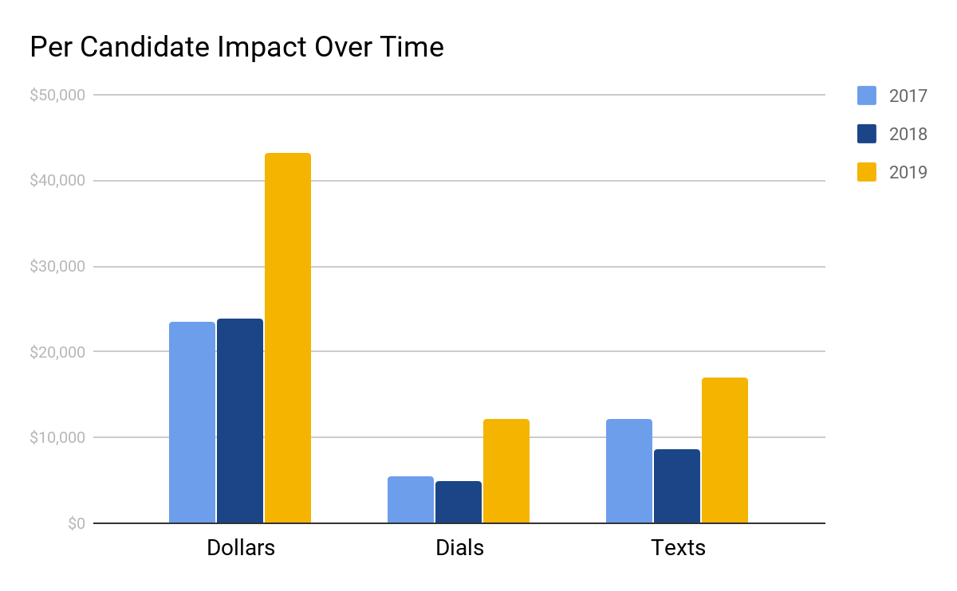
More Efficient and Effective
Blue + Red for a Bluer Tomorrow | www.sisterdistrictma.com
Blue + Red for a Bluer Tomorrow | www.sisterdistrictma.com

Slide 35
Composition of Legislatures:
TX House: 150 seats 64 D / 82R / 3 vacant
MI House: 110 seats . 51 D / 58R / 1 vacant
PA Senate: 50 seats. 21 D / 27 R /1 O / 1 vacant.
PA House: 203 seats. 93 D / 110 R
NC Senate: 50 seats. 21 D / 29 R
NC House: 120 seats. 55 D / 65 R
CO Senate: 35 seats. 19 D / 16 R
GA Senate: 56 seats. 21 D / 35 R
GA House: 180 seats. 75 D / 104 R / 1 vacant
WI State Assembly: 99 seats. 36 D / 63 R
FL Senate: 40 seats. 17 D / 23 R
FL House: 120 seats. 47 D / 73 R

