Slide 1
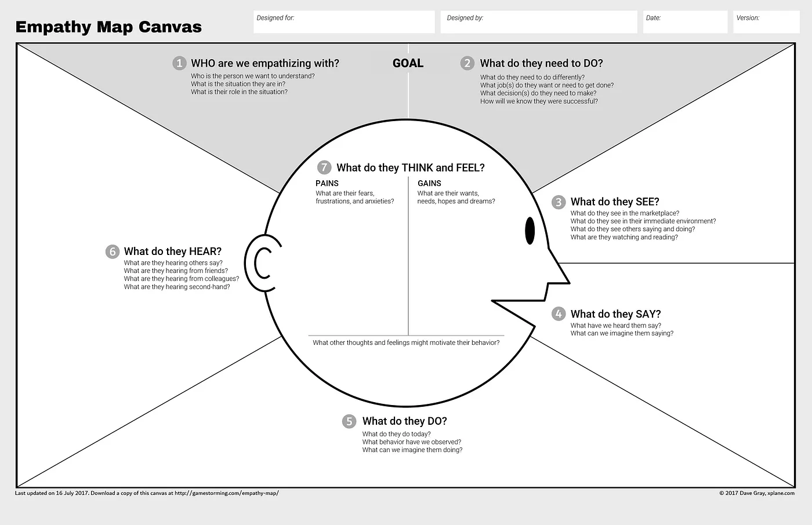
Before contact with group
Notes:
Empathy map instructions

Slide 2
After contact with group
Notes:
Empathy map instructions

Slide 3
Journey from viewing newsletter to becoming relational fundraiser
Gets forwarded email from a friend
Attends group virtual intro session
Donates
Gets follow-up from volunteer to set up 1:1 for answering questions and sharing volunteer opportunities
Joins fundraising team: takes role as relational fundraiser
Takes a break from making dinner to check email, sees it’s forwarded from friend and clicks link
Sees a group of volunteer leaders confident in sharing their story and group. Listens with shyness
Clicks on donation link in follow-up email from event and gives $25
Gets an email from a volunteer. Asks how they decide which candidates to support. Learns about different teams in the group
Commits to raising $1,000. Gets connected to a buddy. Gets invited to a follow-up meeting
“I’ve never really seen myself as an activist. Thank God they’re doing all this work!”
“I don’t know who is in charge. I’m confused about what I can do to help. I’d like to support in ways I can.”
“I’d like to support what these committed people are doing, but I don’t have the experience or time to help.”
“Who is this person? Finally, I can ask the questions I have. Maybe I can help.”
Can I do this? I’ve never done this before and they have so much experience. I wonder what my friends will say.
Anxious, overwhelmed
Guilty for not doing more, grateful
A little relieved, a little less alone, but still unclear if making a difference
Shy, relieved, I matter, some nervousness
They believe in me. Supported. Nervous about talking to friends and family
Include testimonials of current donors/volunteers so people look relatable to them
Allow people to share intros in the chat and share why they joined in breakouts. Create a sense of why–why is this group different?
Follow-up email that shares ways to plug in/stay updated. Thank you call from volunteer.
Person conducting 1:1 must feel relatable - concerned community member like them.
Buddy system to help people prep for fundraising asks to friends and family. Small group support meetings about how to make fundraising asks and get support.
Notes:
Created by PowerLabs

Slide 4
Notes:
Created by PowerLabs

